Slide 1
PIXEL- ALU OPERATIONS

Slide 2
Examples: Adjacency and Path
V = {1, 2}
0 1 1 0 1 1 0 1 1
0 2 0 0 2 0 0 2 0
0 0 1 0 0 1 0 0 1
Weeks 1 & 2

Slide 3

Examples: Adjacency and Path
V = {1, 2}
0 1 1 0 1 1 0 1 1
0 2 0 0 2 0 0 2 0
0 0 1 0 0 1 0 0 1
8-adjacent
Weeks 1 & 2

Slide 4
Examples: Adjacency and Path
V = {1, 2}
0 1 1 0 1 1 0 1 1
0 2 0 0 2 0 0 2 0
0 0 1 0 0 1 0 0 1
8-adjacent
m-adjacent
Weeks 1 & 2

Slide 5
Examples: Adjacency and Path
V = {1, 2}
01,1 11,2 11,3 0 1 1 0 1 1
02,1 22,2 02,3 0 2 0 0 2 0
03,1 03,2 13,3 0 0 1 0 0 1
8-adjacent
m-adjacent
The 8-path from (1,3) to (3,3):
(1,3), (1,2), (2,2), (3,3)
(1,3), (2,2), (3,3)
The m-path from (1,3) to (3,3):
(1,3), (1,2), (2,2), (3,3)
Weeks 1 & 2

Slide 6
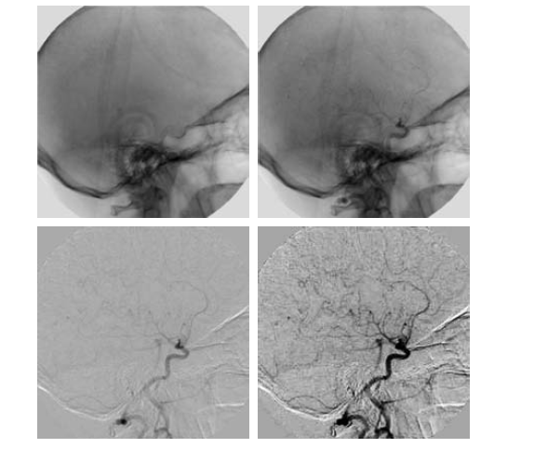
Image Subtraction

Slide 7
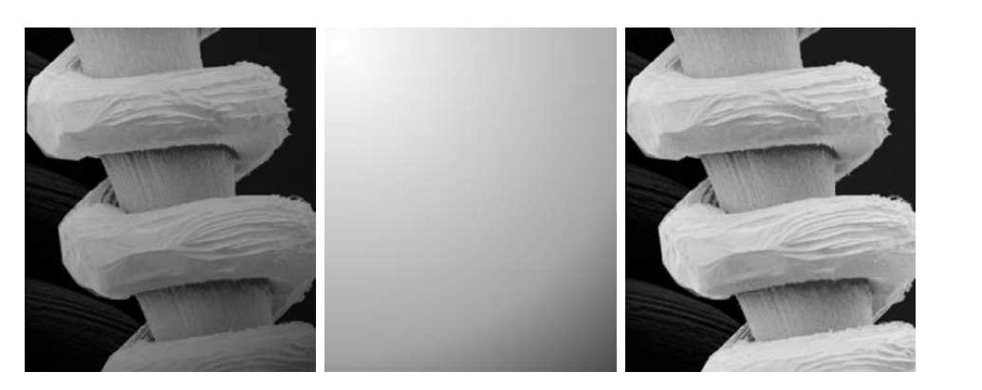
IMAGE MULTIPLICATION

Slide 8
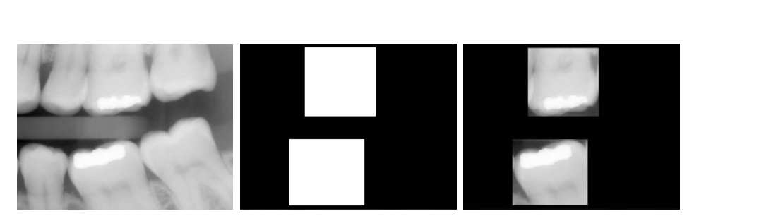
IMAGE MASKING

Slide 9
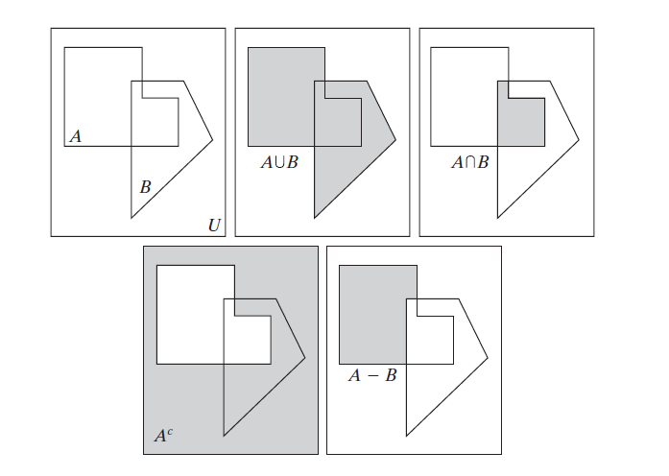

Slide 10
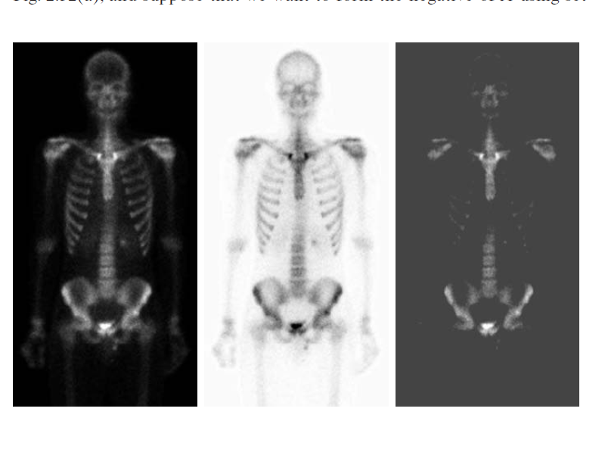
IMAGE NEGATIVE

Slide 11
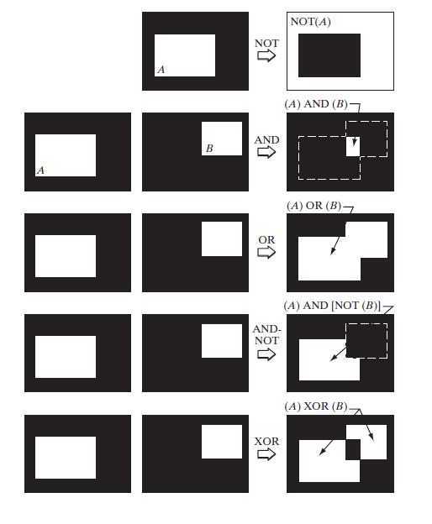
LOGICAL OPERATIONS

Slide 12
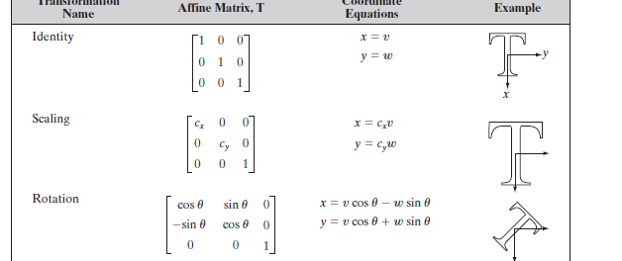
AFFINE TRANSFORMATIONS

Slide 13
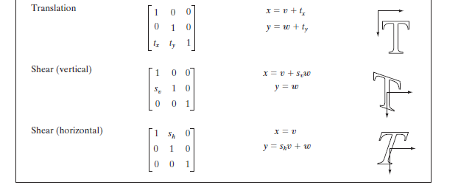
AFFINE TRANSFORMATIONS

